Slide 1

In-Field Testing of Digital Microfluidic Biochips using Multi-Agent Reinforcement Learning
Dr. Sukanta Bhattacharjee
Indian Institute of Technology Guwahati

Slide 2

Presentation Overview
Introduction:
Overview of DMFBs, challenges, and testing.
Problem Definition:
In-Field Testing approach.
Reinforcement Learning-Based In-Field Testing:
Single-agent solution.
Transition to multi-agent solution.
Experimental Setup and Results:
Description of experimental conditions and key findings and insights.
Future Work:
Potential future directions.

Slide 3
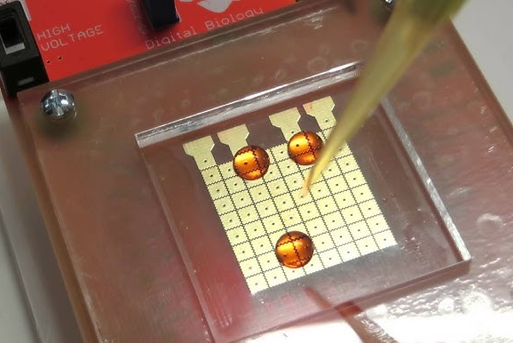
Introduction
What are DMFBs?
Advanced lab-on-chip systems manipulating nanoliter-sized liquid droplets.
Enable automation of biochemical protocols such as clinical diagnostics and drug discovery.
Key Working Principle:
Electrowetting-on-Dielectric (EWOD) technology for droplet movement.
Utilizes a two-dimensional array of electrodes for
precise control.
Applications:
Clinical diagnostics (e.g., COVID-19 rapid testing).
Newborn screening.
Drug discovery and development.
Parallel DNA analysis.

Slide 4
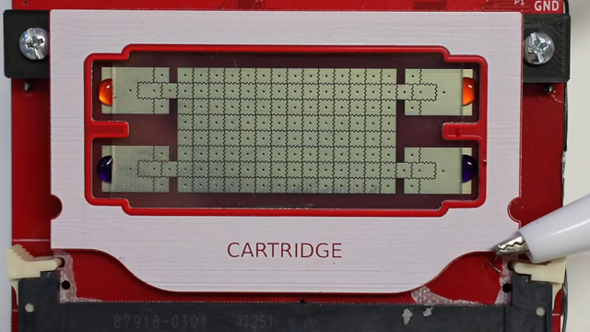
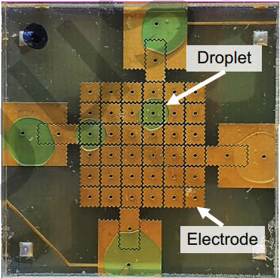
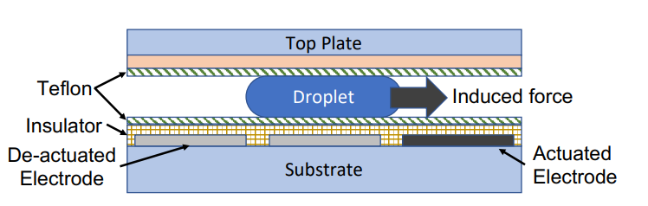
contd.
Video: Demonstrates real-time
operations like dispensing, moving,
mixing, and splitting droplets
on a DMFB.
Figure 1. (a) Top-view of a DMFB. Two droplets are present on the biochip. (b) Illustration of the side-view of a DMFB. The droplet is moved to the right using EWOD.
(b)
(a)

Slide 5
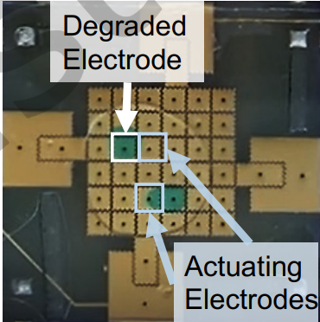
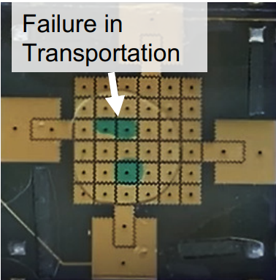
contd.
Challenges:
Electrode Degradation: Over time, electrodes experience wear due to:
Charge residual: Accumulated charges that hinder droplet movement.
Charge trapping: Permanent damage within the dielectric layer.
Droplet Transportation Failures:
Movement impeded by degraded electrodes.
Increased chances of bioassay failure.
Risk of Contamination
Unintended merging of droplets due to close proximity during routing.
Since DMFBs are prone to defects like electrode degradation, there is an immediate need for testing to ensure the reliability of the chip and the integrity of bioassay outcomes.

Slide 6
Problem Definition
In-Field Testing: It involves running structural tests concurrently with bioassay operations to detect and diagnose defects without interrupting or compromising the assay's integrity​
Procedure:
We route test droplets on the biochip simultaneously with assay droplets.
The test droplet is routed in such a way that it covers all the cells used by the assay droplets, ensuring no collisions occur at any point.
After covering all necessary cells, the test droplet is directed to the sink.
The overall objective is to determine this route efficiently and effectively.
If the test droplet successfully reaches the sink at the end of the test, the chip is considered fault-free; otherwise, it is identified as faulty.

Slide 7
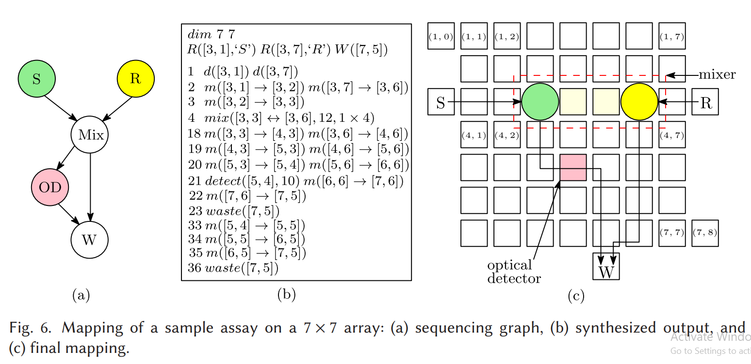
contd.
Test Plan:

Slide 8
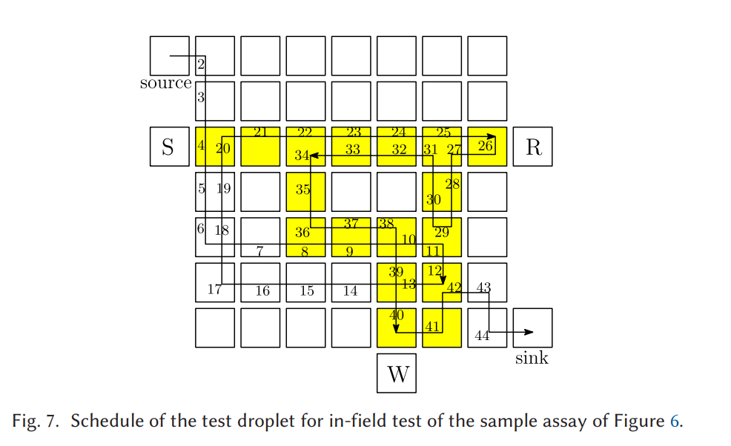
contd.

Slide 9
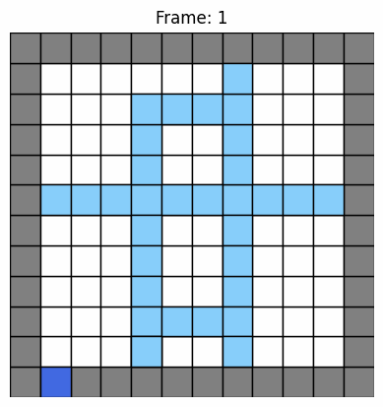
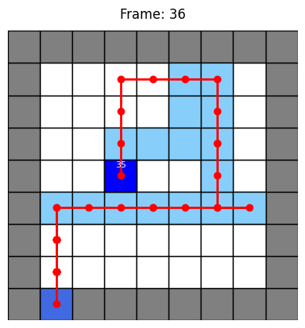
contd.
Challenges with Current Methods:
SAT and ILP-based structural testing methods are time-consuming and not suitable for real-time applications.
Current approaches lack scalability and efficiency for detecting defects during ongoing assays.
Proposed Solution:
Use Reinforcement Learning (RL) algorithm’s to navigate test droplets for edge-based in-field testing.
Ensure droplets cross boundaries between adjacent electrodes on time to detect:
Electrical Shorts: Between adjacent electrodes.
Immobile or Stuck-at Electrodes: Preventing droplet movement.
Slow-Moving Droplets: Caused by degradation, contamination, or dielectric breakdown.

Slide 10
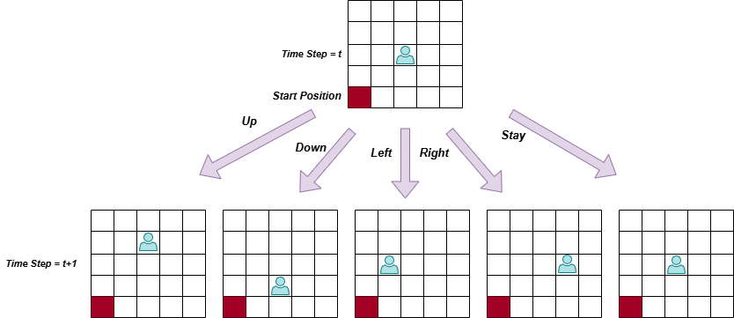
Reinforcement Learning-Based In-Field Testing
Single Agent Solution:
State (S):
S_{t}​ = (agent_pos , time_step)
Action (A):
A = {Up, Down, Left, Right, Stay}
Transition Probabilities (P_{sa}):
P (s′, r | s, a) =
(1 - ε) + (ε/5), agent reached to state s’
4 * (ε/5), agent reached to some other state

Slide 11
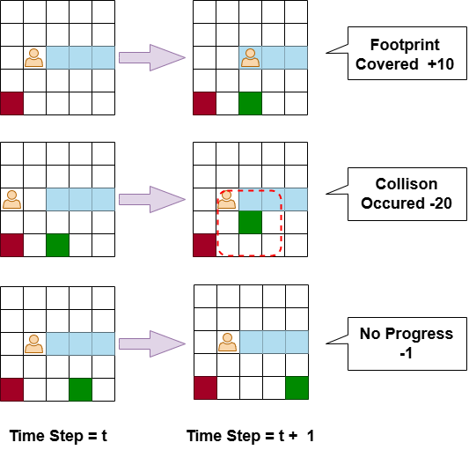
contd.
Reward (R):
+10 for covering a footprint.
-20 for colliding with an obstacle.
-1 for non-rewarding moves.
Additional bonus at the end of Episode:
R_{t} ​= 50 × (total_footprints / covered_footprints​)
Now we have to solve this MDP so agent has a way to behave optimally in the environment and maximize his reward.

Slide 12
contd.
Why Q Learning?
Q-learning doesn't require prior knowledge of the environment's dynamics. It learns directly through interaction, making it versatile for various applications.
Easy to implement and suitable for a wide range of problems, especially in discrete state-action spaces like grids or games.
Given enough exploration and updates, Q-learning converges to the optimal policy, ensuring the best possible decisions in any environment.
Can be extended to multi-agent systems and more complex environments without requiring a complete redesign.

Slide 13
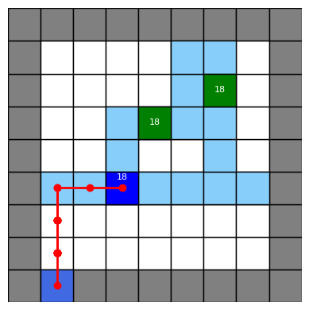
contd.
Q-Learning Algorithm (Epsilon Greedy):
Q-learning focuses on learning the action-value function Q(s , a)
Input: A state s and an action a.
Output: A real number, called the Q-value
The goal of Q-learning is to learn the Q-values to maximize the total reward over time.
Uses an epsilon-greedy approach to balance exploration and exploitation (Behaviour Policy).
Learn an optimal policy by converging the Q-values (Target Policy).
Q-Table
Q | a1 | a2 | a3 | .
s1 | -1.2 | 1 | 2.1 | .
s2 | 0.5 | 0.75 | -0.5 | .
s3 | -1.2 | 1.2 | 0.7 | .
. | . | . | . | .
Q(s₁,a₁)_{observed} = R(s₂) + Y max_{a’} Q(s₂,a’) → Bellman Equation Q(s₁,a₁)_{current} T.D. Error = Q(s₁,a₁)_{observed} - Q(s₁,a₁)_{current} Q(s₁,a₁)←Q(s₁,a₁) + α [R(s₂) + Y max​_{a’} Q(s₂,a′) − Q(s₁,a₁)]

Slide 14
contd.
Q-Learning Algorithm (Optimistic Greedy):
Optimistic Greedy Q-Learning focuses on learning the action-value function Q(s,a) with high initial Q-values to encourage exploration.
Input: A state s and an action a.
Output: A real number, called the Q-value
The goal of Q-learning is to learn the Q-values to maximize the total reward over time.
The goal is to maximize the total reward by initially favoring unexplored actions through optimistic initialization.
Q-Table
Q | a1 | a2 | a3 | .
s1 | -1.2 | 1 | 2.1 | .
s2 | 0.5 | 0.75 | -0.5 | .
s3 | -1.2 | 1.2 | 0.7 | .
. | . | . | . | .
Actions are chosen greedily without explicit randomness (e.g., no need for ε-greedy).
Initial Q-values are set to high values (e.g., 𝑄(𝑠,𝑎)=100), leading to natural exploration.
Learned by gradually updating the Q-values based on actual rewards.

Slide 15
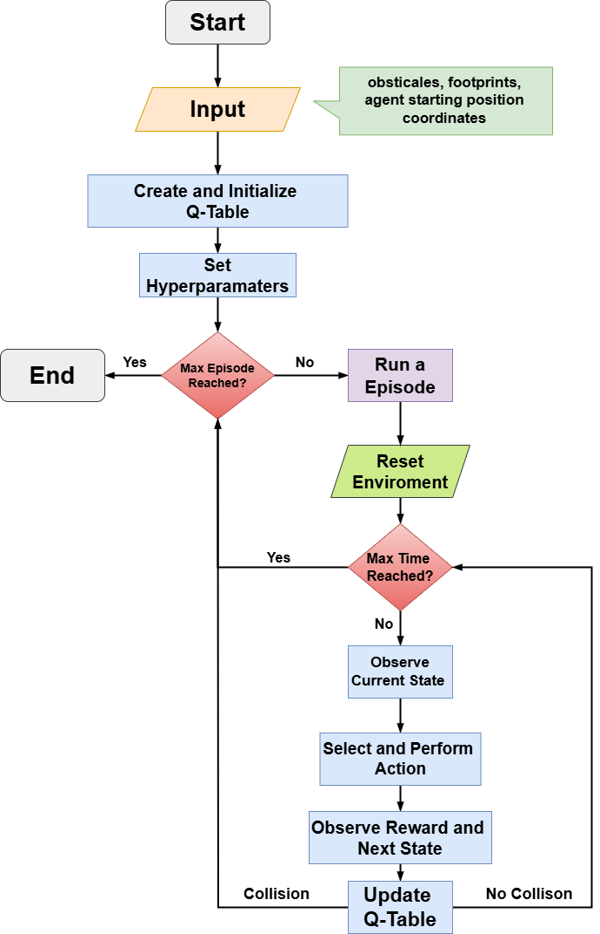
contd.

Slide 16

contd.
Multi-Agent Solution:
It’s a extension of the single-agent solution where:
Each agent learns independently to maximize its own reward.
A priority system is implemented:
In a 2-agent system, Agent 1 moves first.
Agent 2 selects an action and checks if it will not result in a collision with Agent 1's new position.
If no collision is predicted, Agent 2 moves.
If a collision would occur, Agent 2 remains in its current position.
If a collision happens, only Agent 1 is penalized.
The rest of the framework remains unchanged.

Slide 17
Experimental Setup and Preliminary Results
Table 1. Summary of Experimental Assays for Evaluation
Test ID | Assay Name | Dimension | T_assay
Assay 1 | Sample assay InVitro | 7 X 7 | 36
Assay 2 | Sample preparation using REMIA | 10 X 10 | 61
Assay 3 | PCR mixture | 8 X 15 | 62
Assay 4 | Multiplexed Glucose-Lactate assay | 15 x 15 | 77
Assay 5 | Multiplexed InVitro | 16 x 16 | 160
Assay 6 | PCR & REMIA & Multi Glucose | 31 x 25 | 76
Assay 7 | Sample assay of 8 Reagents | 30 x 30 | 82
Assay 8 | Multiplexed InVitro & Glucose | 31 x 16 | 160
Assay 9 | Multi REMIA | 50 x 50 | 240

Slide 18
contd.
Table 2. Result Comparison between RL and SAT
Test ID | Grid Size | Assay Time | #Footprints | # Agents | Test Application Time RL | Running time (RL1) Epsilon Greedy | Running time (RL2) Optimistic Greedy | SAT TIME | Test Application Time SAT
Assay 1 | 7 x 7 | 36 | 17 | 1 | 48 | 027.546124 | 24.929749 | 0.74 | 45
Assay 2 | 10 x 10 | 61 | 31 | 1 | 90 | 122.930954 | 108.421589 | 5.83 | 85
Assay 3 | 8 x 15 | 62 | 60 | 2 | 74 | 175.916366 | 161.434342 | 6.73 | 68
Assay 4 | 15 x 15 | 77 | 58 | 2 | 102 | 321.887126 | 255.739321 | 57.88 | 81
Assay 5 | 16 x 16 | 160 | 192 | 4 | 172 | 1147.344812 | 1087.952784 | 18,637.59 | 160
Assay 6 | 30 x 30 | 82 | 266 | 4 | 96 | 975.823774 | 749.954697 | 17,652.90 | 90
Assay 7 | 31 x 25 | 76 | 238 | 4 | 81 | 754.553429 | 689.256114 | 14,223.64 | 72
Assay 8 | 31 x 16 | 160 | 250 | 4 | 173 | 958.814566 | 901.348518 | 20,198.12 | 160
Assay 9 | 50 x 50 | 240 | 775 | 4 | 277 | 2751.76812 | 2598.612227 | Timeout | Timeout

Slide 19
Future Work
Exploring Advanced Learning Algorithms: Investigate neural network-based methods (e.g., DQN, DDQN) for enhanced performance and scalability.

